Slide 1
Task 1
Identifying categories of hate memes

Slide 2
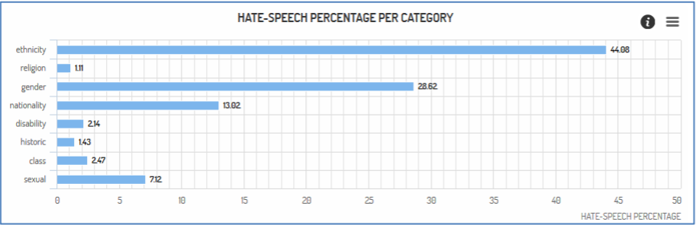
Hate speech categories selected
Ethnicity
Gender
Nationality
sexism

Slide 3
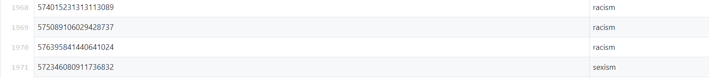

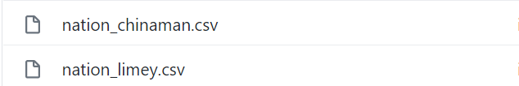
Dataset
2
3

Slide 4
References
http://mandola-project.eu/m/filer_public/06/b9/06b92efd-cce2-4204-a2a9-5eb2c34912f7/mandola-d31.pdf
https://github.com/ZeerakW/hatespeech/blob/master/NAACL_SRW_2016.csv
https://github.com/mayelsherif/hate_speech_icwsm18/tree/master/nhsm_datasets

Slide 5
Task 2 : Reasoning Of Meme Labelled Into Different Categories

Slide 6
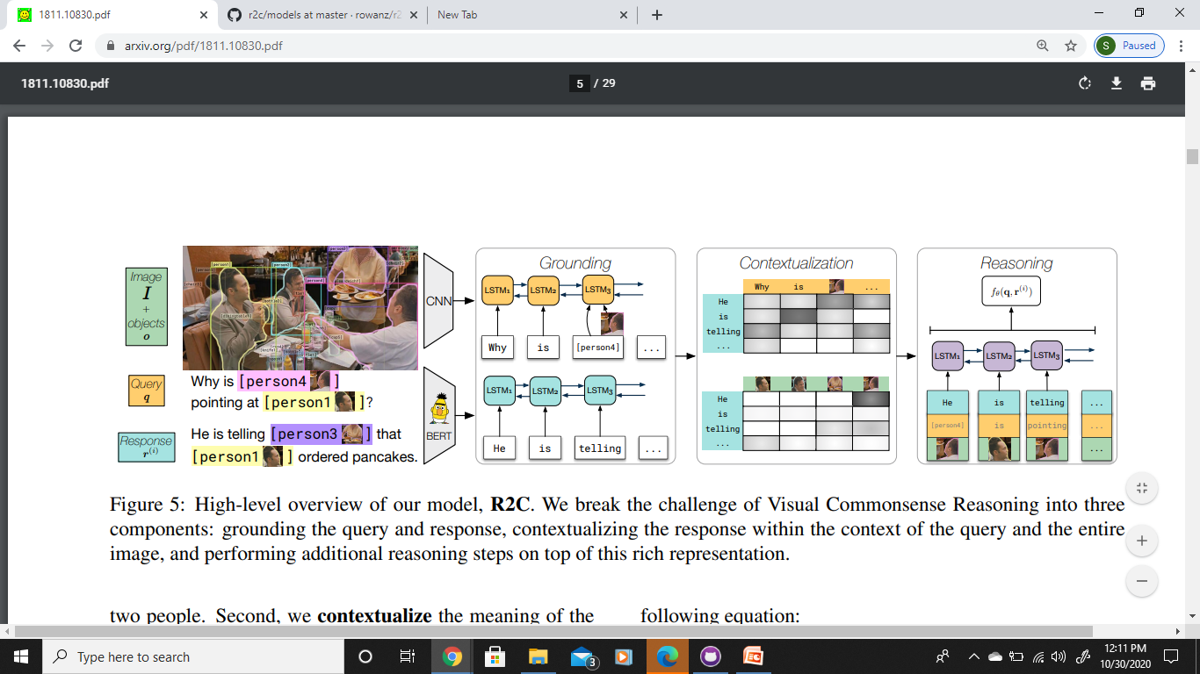
From Recognition to Cognition: Visual Commonsense Reasoning
https://arxiv.org/pdf/1811.10830.pdf
Dataset : Visual Commonsense Reasoning
Collected from Large Scale Movie Description Challenge and YouTube movie clips
List of objects
A query
A set of N responses
Recognition to Cognition Network
QA -> R
Grounding
Contextualization
Reasoning

Slide 7
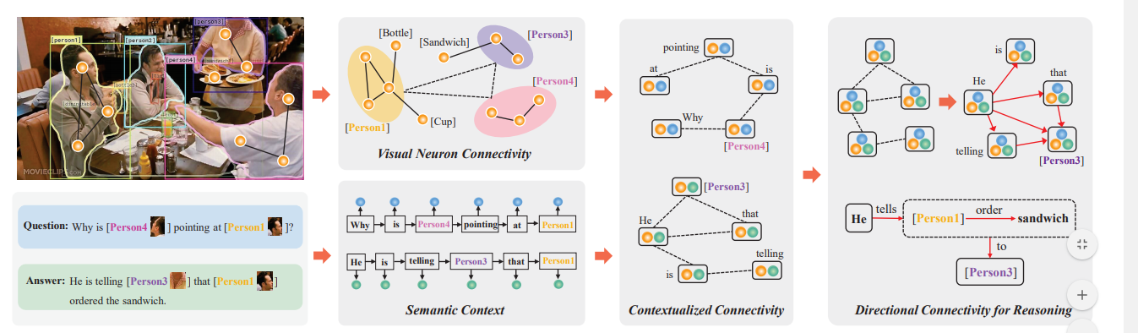
Connective Cognition Network for Directional Visual Commonsense Reasoning
https://papers.nips.cc/paper/2019/file/8a56257ea05c74018291954fc56fc448-Paper.pdf

Slide 8
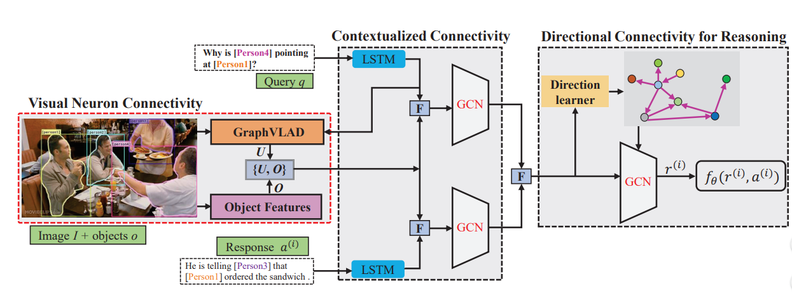

Slide 9
Leveraging Visual Question Answering for Image-Caption Ranking
Xiao Lin Devi Parikh
Bradley Department of Electrical and Computer Engineering,
Virginia Tech
{linxiao,parikh}@vt.edu

Slide 10
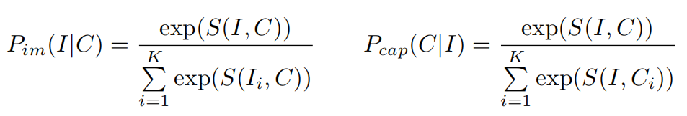
Image caption ranking
The image-caption ranking task is to retrieve relevant images given a query caption and relevant captions given a query image.
During training we are given image-caption pairs (I, C)
For each pair we sample K - 1 other images in addition to I so the image retrieval task becomes retrieving I from K images given caption C.
We also sample K-1 random captions in addition to C so the caption retrieval task becomes retrieving C from K given image I.
The image-caption ranking models learn a ranking scoring function S(I, C) such that the corresponding retrieval probabilities are maximised:

Slide 11
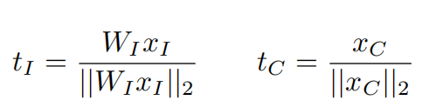
Baseline model
Model projects
D_{xI} - dimensional CNN activation xI for image I
D_{xC}- dimensional RNN latent encoding xC for caption C
to the same D_{xC}-dimensional common multi-modal embedding space as unit-norm vectors t_{I} and t_{C} :
The multi-modal scoring function is defined as their dot product St(I, C) =<t_{I} , t_{C} >.

Slide 12
VQA and VQA-Caption
VQA is the task of given an image I and a free-form open-ended question Q about I, generating a natural language answer A to that question.
Similarly,VQA-Caption task takes a caption C of an image and a question Q about the image, then generates an answer A.
During training, given triplets of question Q ,ground truth answer A
Image I,
We optimize the negative log-likelihood (NLL) loss to maximize the probability of the ground truth answer PI (A|Q, I) given by the VQA model.
Caption C,
We optimize the NLL loss to maximize the VQA-Caption model probability PC (A|Q, C).

Slide 13
For a VQA question (I, Q)
Image Encoding
Using the 19-layer VGGNet [46] as a 4,096-dimensional image encoding x_{I}
Question Encoding
Using a 2-layer RNN with 512 Long Short-Term Memory (LSTM) units per layer as a 2,048-dimensional question encoding x_{Q}.
Then x_{I} and x_{Q} are projected into a common 1,024-dimensional multi-modal space as z_{I} and z_{Q}
We then compute the representation z_{I+Q} for the image-question pair (I, Q) by element-wise multiplying z_{I} and z_{Q}
The scores s_{A} for 1,000 answers are given by: s_{A} = W_{s}z_{I+Q} + b_{s}

Slide 14
For the VQA-Caption task given caption C and question Q,
We use the same network architecture and learning procedure as above
But using the most frequent 1,000 words in training captions as the dictionary to construct a 1,000 dimensional bag-of-words encoding for caption C as x_{C} to replace the image feature x_{I} and compute z_{C} , z_{C+Q} respectively.
The VQA and VQA-Caption models are learned on the train split of the VQA dataset using
82,783 images, 413,915 captions and 248,349 questions.
These models achieve VQA validation set accuracies of
54.42% (VQA) and 56.28%(VQA-Caption).
Next, they are used as sub-modules in the image caption ranking approach.

Slide 15
Approach
To leverage knowledge in VQA for image-caption ranking we propose
to represent the images and the captions in the VQA space using VQA and VQA-Caption models.
This representations is called VQA-grounded representations.

Slide 16
Let’s say we have a
VQA model PI (A|Q, I), a VQA-Caption model PC (A|Q, C)
Set of N questions Qi
And their plausible answers (one for each question) Ai, i = 1, 2, ...N.
Then given an image I and a caption C, we first extract the N dimensional VQA-grounded activation vectors u_{I} for I and u_{C} for C
Such that each dimension i of u_{I} and u_{C} is the log probability of the ground truth answer Ai given a question Qi.

Slide 17
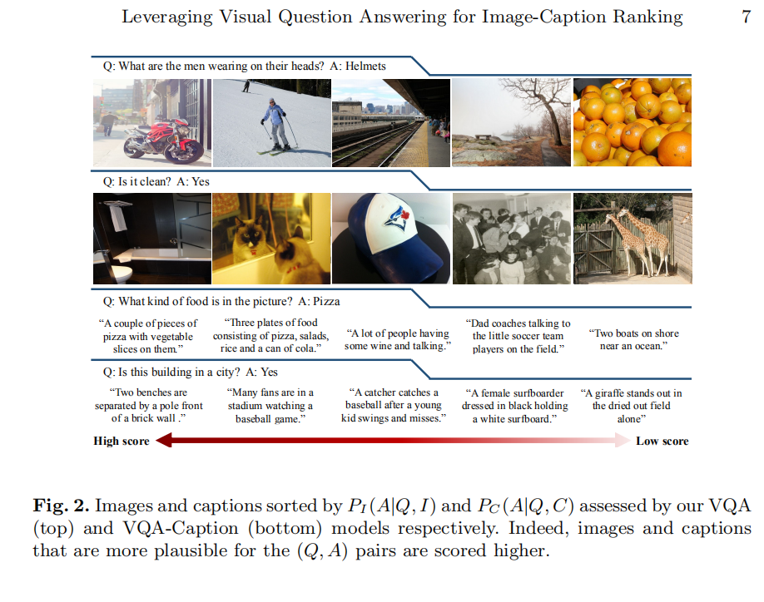
For example if the (Qi, Ai) pairs are
(Q1: What is the person riding?, A1:Motorcycle)
(Q2: What is the man wearing on his head?, A2: Helmet),
u(1)I and u(1)C verify if the person in image I and caption C respectively is riding a motorcycle.
At the same time u(2)I and u(2)C
verify whether the man in I and C
is wearing a helmet.

Slide 18
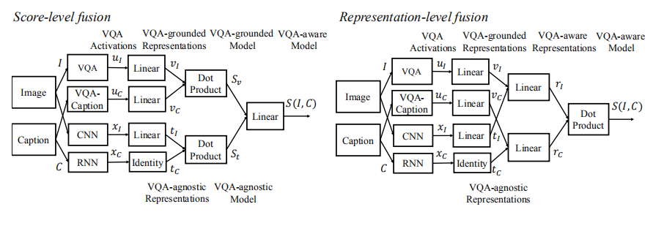

https://arxiv.org/pdf/1605.01379.pdf

Slide 19
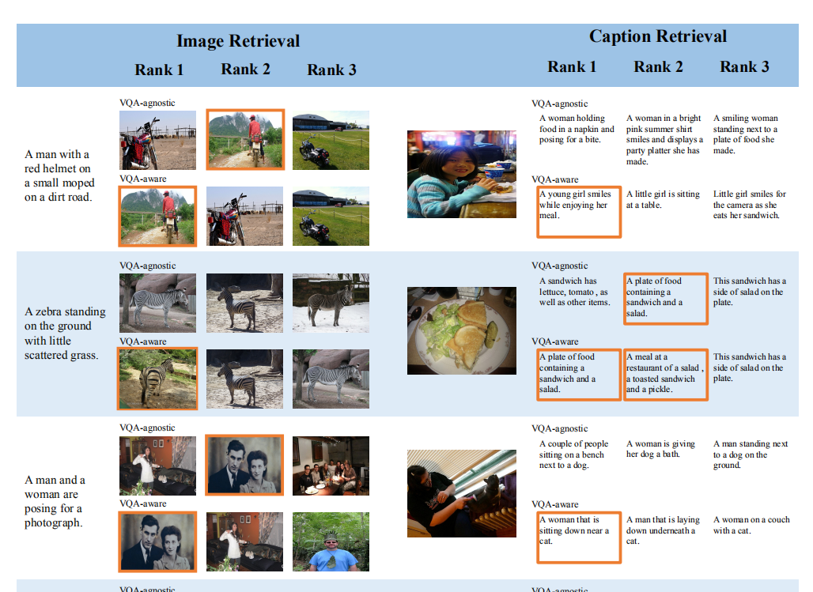

Slide 20
